Slide 1
Differential expression analysis
October 25, 2024 | CMDB Quantitative Biology Lab

Slide 2
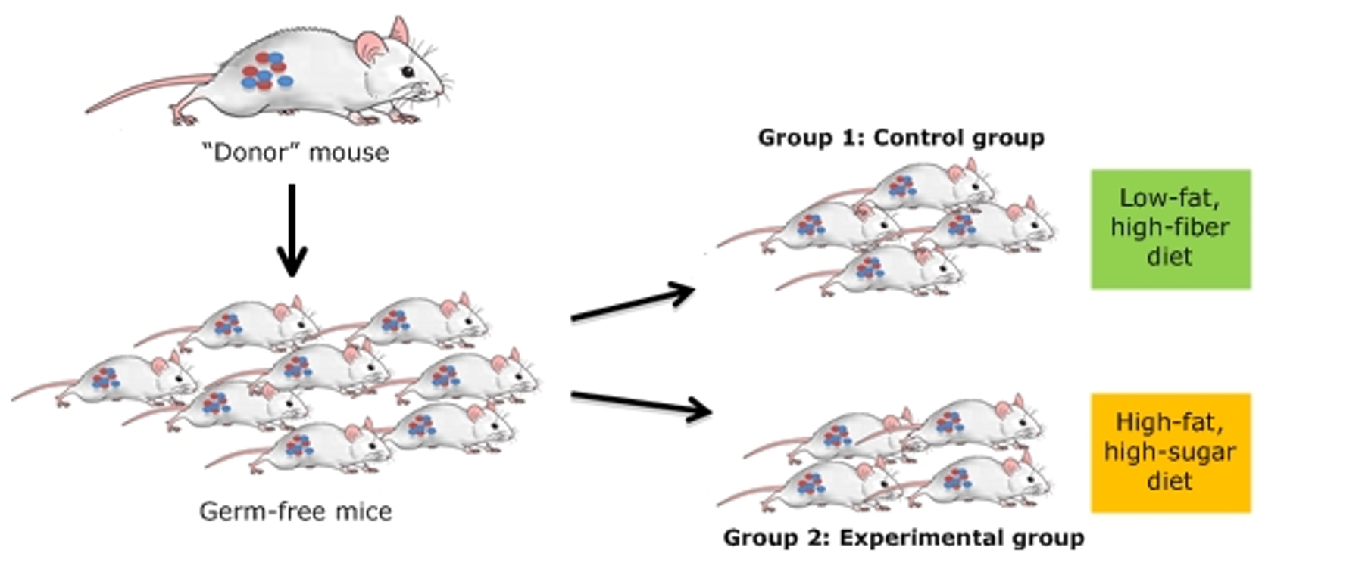
Testing for expression differences (differential expression)

Slide 3
Which normalization should be used for DE analysis?
DESeq2 ”Median of Ratios”
No need to account for gene length (since the comparisons are for one given gene at a time)
For each gene, create a pseudo-reference sample (geometric mean count across samples)
For each sample, compare its expression to the reference as a ratio.
For each sample, take the median of those ratios across genes to get a ”normalization size factor” for that sample.
These size factors are used as “offsets” (i.e., a co-variate with a known value that we do not estimate) in the downstream test for differential expression (linear regression model).

Slide 4
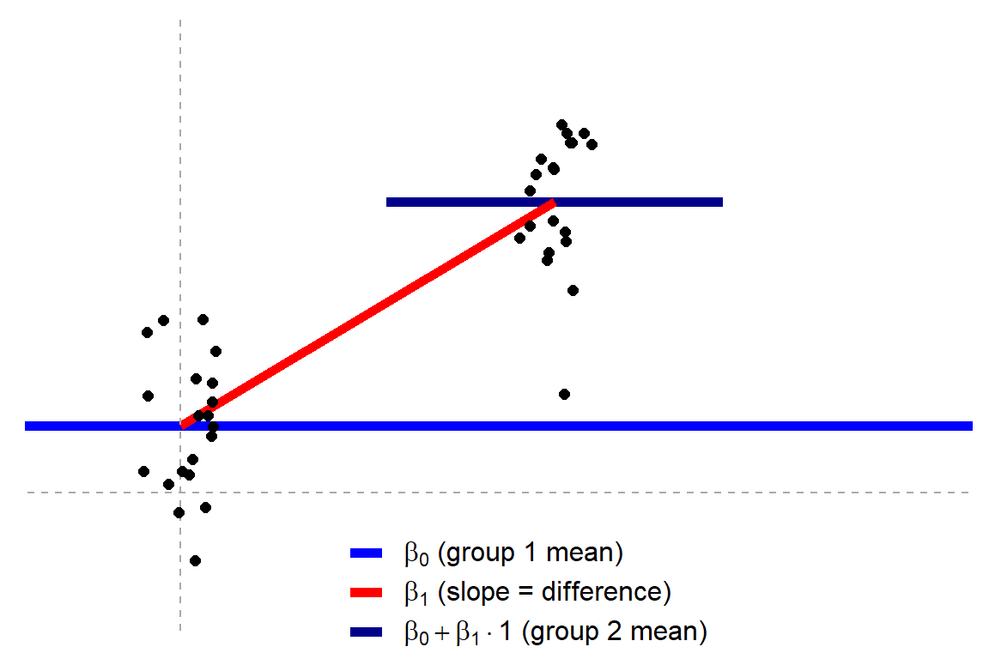
Independent t-test?
For each gene…
𝑦 = 𝛽₀ +𝛽₁𝑥_{i}
where x_{i} is an indicator variable (0 or 1) that tells us to which group the data point belongs.
Jonas Kristoffer Lindeløv: https://lindeloev.github.io/tests-as-linear/
Notes:
For example, an independent t-test is just simple linear regression model, but with a single binary predictor variable (also called an indicator variable or dummy variable). The indicator variable takes the value zero or one, to indicate to which group each point belongs. We then test whether the slope (beta-1) is significantly different than the null hypothesis of zero.

Slide 5
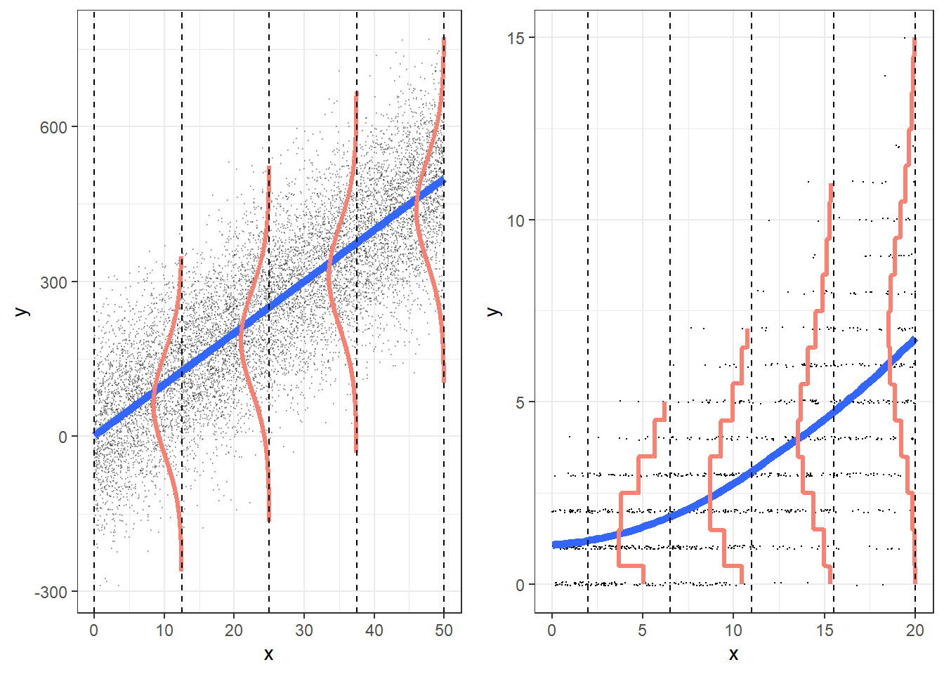
A better approach is to model the read counts…
Linear regression
Poisson regression
Notes:
A better way of modeling gene expression is to actually model the counts of reads aligned to the gene in each sample. OLS regression is not appropriate for count data, which 1) cannot be negative, 2) have a different shaped distribution.
Counts can be modeled with Poisson regression, however, Poisson models assume that the mean and variance are equal.

Slide 6
But there is more variance than Poisson assumes
Technical + biological variability
Technical variability alone
Poisson expectation
σ² = μ
Notes:
black is technical variability alone; red includes variability across samples; blue is Poisson expectation

Slide 7
Negative binomial models allow for extra dispersion
Negative binomial model
σ² = μ + φμ²
Technical + biological variability
Technical variability alone
Poisson expectation
σ² = μ
Notes:
black is technical variability alone; red includes variability across samples; blue is Poisson expectation

Slide 8
How is the dispersion parameter (φ) estimated?
For a given gene…
Φ = (σ / μ)²
Notes:
DESeq2 estimates gene-level dispersion parameters by examining the mean-dispersion relationship and sharing information across genes with similar mean expression

Slide 9
How is the dispersion parameter (φ) estimated?
DESeq2 “shrinks” these dispersion estimates
Notes:
DESeq2 estimates gene-level dispersion parameters by examining the mean-dispersion relationship and sharing information across genes with similar mean expression

Slide 10
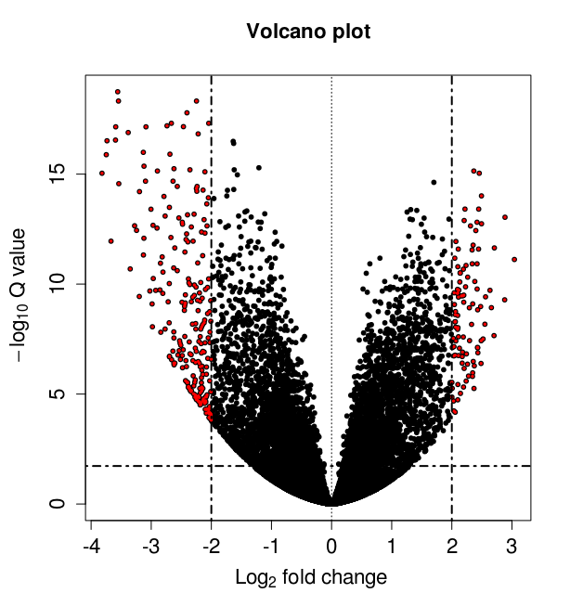
Visualizing your results (Volcano plot)

Slide 11
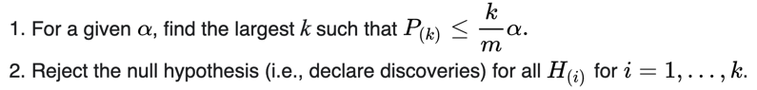
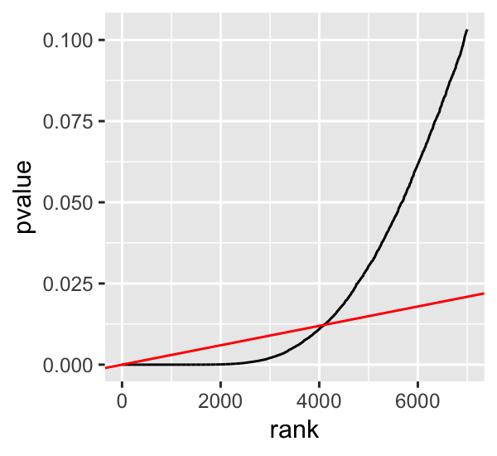
Controlling the false discovery rate (FDR)
The false discovery rate (FDR) is the expected proportion of Type 1 errors out of all rejections of the null hypothesis. Examples of FDR correction include the Benjamini-Hochberg procedure. Test k hypotheses and obtain p-values.
ordered p-values
slope = α / m
FDR is the expected proportion of type I errors out of all of the rejections the null hypothesis.
Notes:
The second basic approach to addressing type I errors during multiple testing is by controlling what is called the false discovery rate. The false discovery rate is the expected proportion of type I errors out of all of the rejections the null hypothesis. So if alpha is 0.05, we are saying that we will allow up to 5% false positives among the test we call significant.
A common approach to FDR correction is the Benjamini-Hochberg procedure. We won’t go over it in detail this afternoon, but the basic algorithm is described here and may be covered later in quant lab.

Slide 12
Visualizing your results (Volcano plot)

